Slide 1
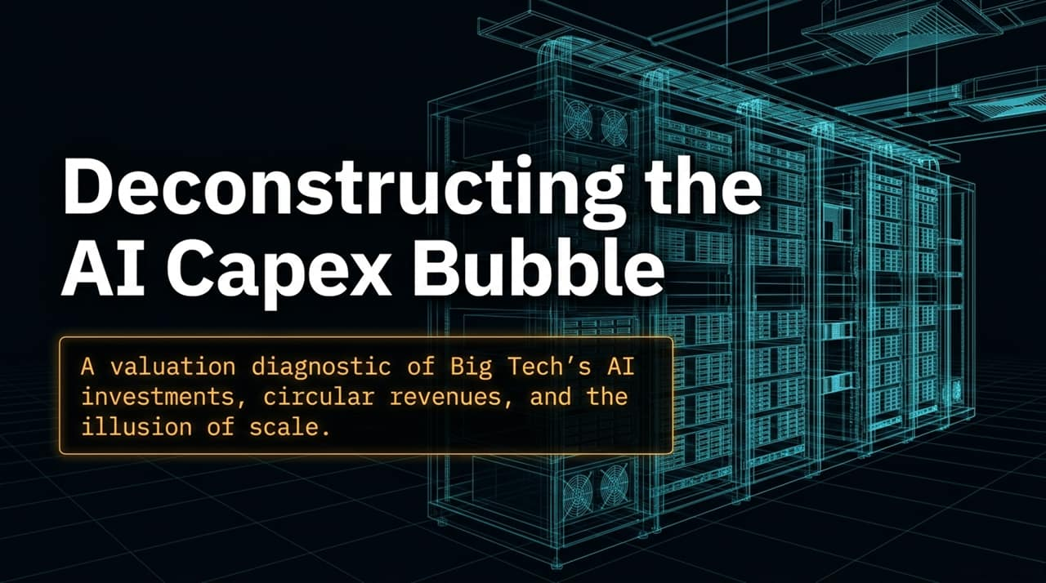
Notes:
Opening Statement: Good morning/afternoon, everyone. Today, we are taking a deep dive into what is rapidly becoming the single defining financial narrative in global equity markets: Big Tech’s AI capital expenditure cycle.
Core Thesis: For the past decade, Big Tech built unmatched economic moats using capital-light software models. Today, however, we are witnessing a fundamental paradigm shift as these mega-cap giants inject hundreds of billions of dollars into AI infrastructure.
Key Questions for Today:
Where is this money actually going, and is there organic end-user demand to justify it?
How are circular revenue flows and paper investment gains skewing corporate earnings and multiples
https://www.youtube.com/watch?v=vE_FR0O-Jhk

Slide 2
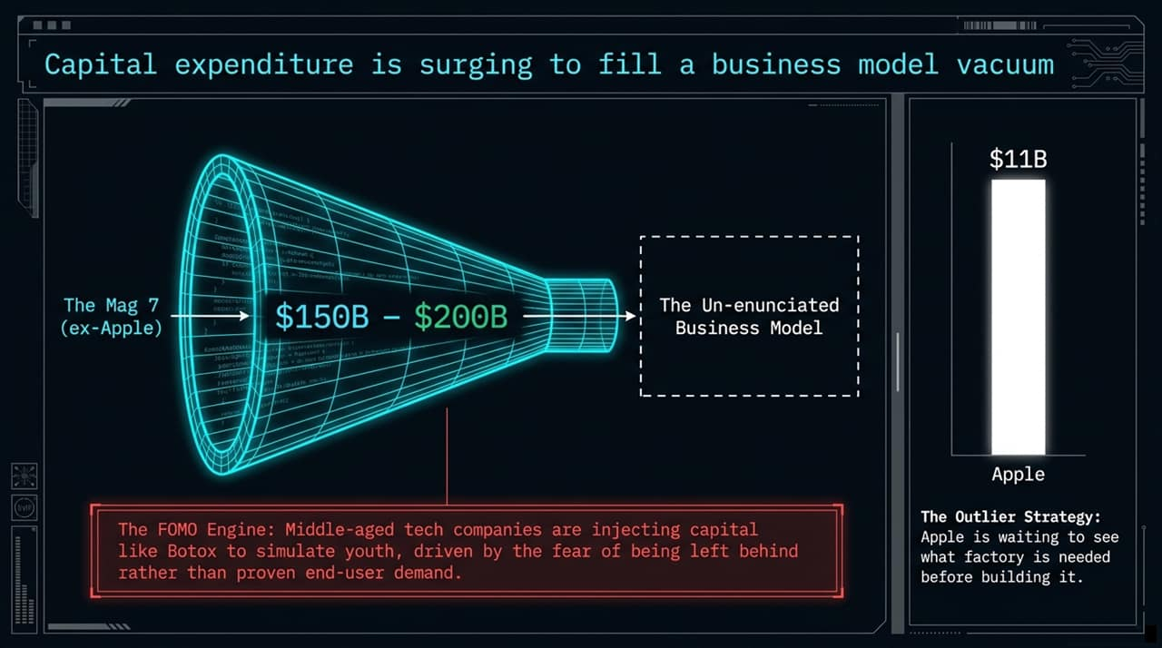
Notes:
Visual Context: Looking at the visual funnel, the Magnificent 7 (excluding Apple) are funneling an unprecedented $150B to $200B in annual CapEx into what we call the "Un-enunciated Business Model".
The "FOMO" Engine: As Professor Aswath Damodaran notes, these mature, middle-aged tech companies are injecting capital like Botox to simulate youth. Their capital deployment is driven heavily by fear—the fear of being left behind or declared obsolete—rather than proven, predictable end-user demand.
Lack of Articulated Business Strategy: Spending money is easy; articulating a clear business model is what creates long-term value. Currently, Big Tech hyperscalers have not clearly communicated whether they are pursuing a high-margin premium niche or a low-margin mass-market scale model. When management leaves a strategic vacuum, the market fills it with skepticism.
The Strategic Outlier — Apple: Apple stands out with an annual CapEx of just $11B. Tim Cook is executing a classic "wait-and-see" strategy—waiting to observe what kind of factory is actually needed before committing hundreds of billions to build it.

Slide 3
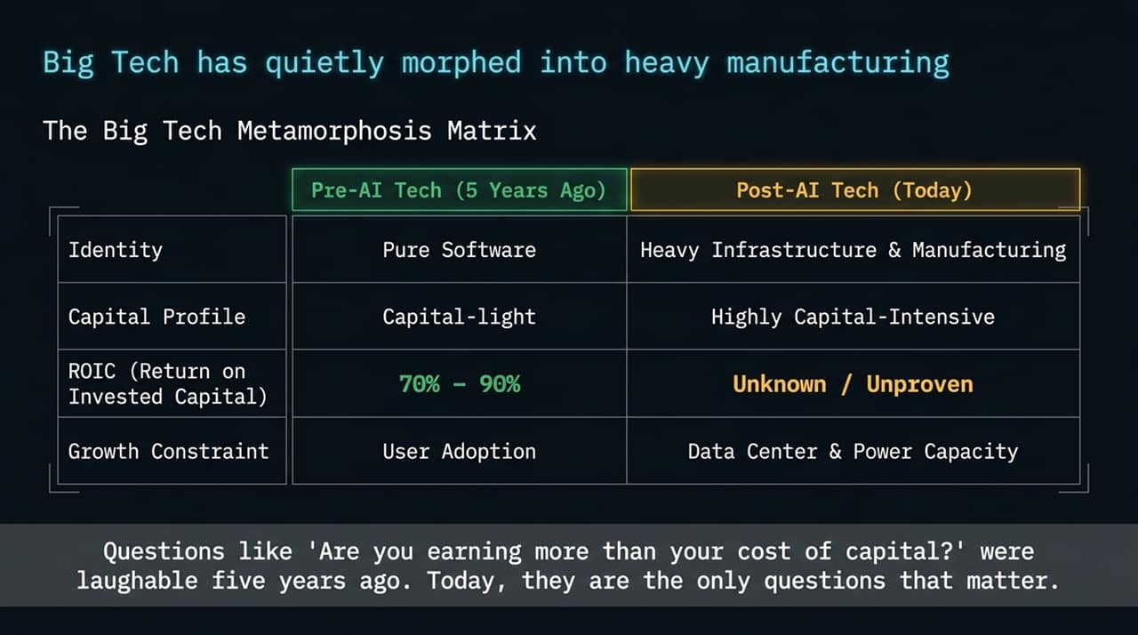
Notes:
The Structural Shift: Five years ago, Big Tech operated purely as capital-light software enterprises. Today, they are heavy infrastructure and manufacturing businesses.
Key Matrix Highlights:
Identity: Transitioned from pure, scalable software to physical power, server, and data center buildouts.
ROIC: Returns on invested capital used to range between 70% and 90%. Now, returns are unproven and trending downward under massive capital requirements.
Growth Constraint: Growth is no longer constrained by user adoption or customer acquisition, but by physical power grids, land access, and data center capacity.
Valuation Implication: Questions like "Are you earning more than your cost of capital?" were irrelevant for pure software companies five years ago. Today, as capital-intensive builders, ROIC vs. WACC is the single most crucial hurdle rate they must clear.

Slide 4
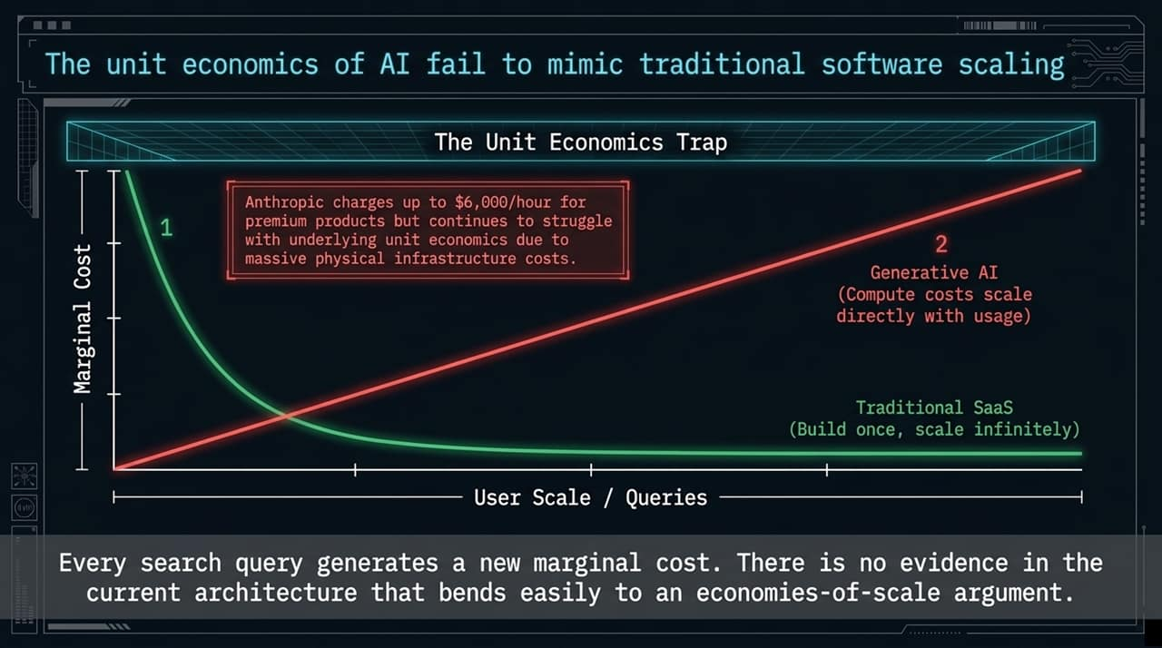
Notes:
The SaaS vs. AI Divergence: Traditional software/SaaS follows a classic curve: build once, deploy infinitely, and watch marginal cost asymptotically approach zero. Generative AI completely breaks this dynamic.
Linear Marginal Costs: In LLM inference, every search query and every token generated incurs a direct, non-zero compute cost. There is currently no architectural evidence that AI compute benefits from standard software economies of scale.
The Unit Economics Trap: Frontier AI labs charge premium rates—for example, Anthropic charging up to $6,000/hour for high-end enterprise API access—yet they still struggle with underlying unit economics due to massive compute overhead.
Takeaway: Scaling up user queries does not automatically expand profit margins; without fundamental architectural breakthroughs, higher usage linearly increases operating expense.

Slide 5
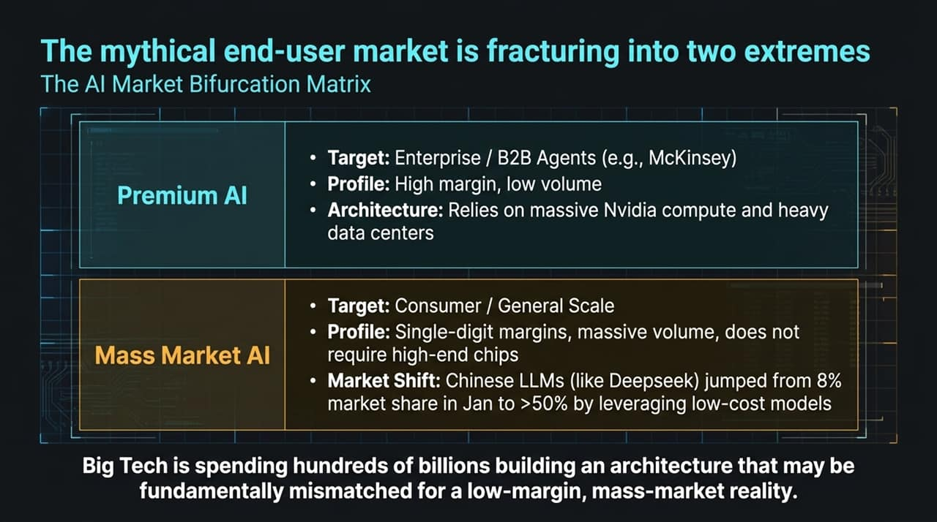
Notes:
Market Bifurcation: The end-user market for AI is splitting into two distinct sectors:
Premium Enterprise AI: High-margin, low-volume solutions targeting enterprise workflows (e.g., specialized McKinsey/law firm AI agents). This segment requires expensive Nvidia GPUs and massive data infrastructure.
Mass Market Consumer AI: Low-margin, high-volume consumer applications that do not require top-tier infrastructure.
The Threat of Low-Cost Models: Open-source and low-cost Chinese LLMs (e.g., DeepSeek) rapidly grew their token market share from 8% in January to over 50% by delivering competitive results at a fraction of the compute cost.
The Core Risk: Big Tech hyperscalers are spending hundreds of billions building an ultra-expensive infrastructure stack that may be fundamentally over-engineered for a low-margin, commoditized mass market.

Slide 6
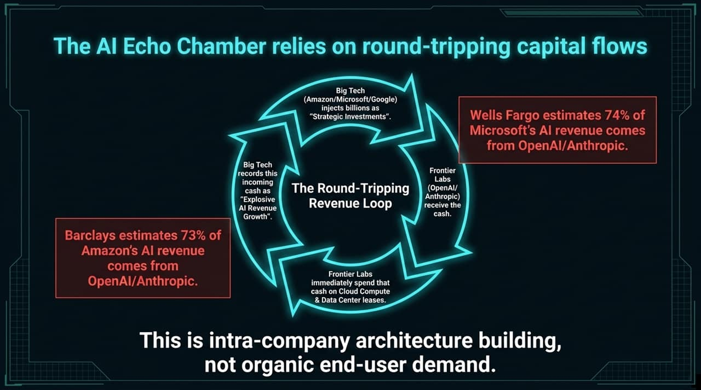
Notes:
The Circular Ecosystem: A significant portion of reported "explosive AI growth" is closed-loop capital:
Big Tech hyperscalers (Amazon, Microsoft, Google) inject billions in "strategic investments" into frontier labs (OpenAI, Anthropic).
Frontier labs receive the cash and immediately spend it back with those same hyperscalers on cloud compute and data center leases.
Hyperscalers record these incoming lease payments as "explosive AI revenue growth".
Wall Street Estimates:
Barclays estimates that 73% of Amazon's AI revenue originates directly from OpenAI and Anthropic compute spend.
Wells Fargo estimates that 74% of Microsoft's AI revenue comes from OpenAI and Anthropic.
Conclusion: This represents intra-company architecture building and vendor financing rather than organic end-user commercial adoption.

Slide 7
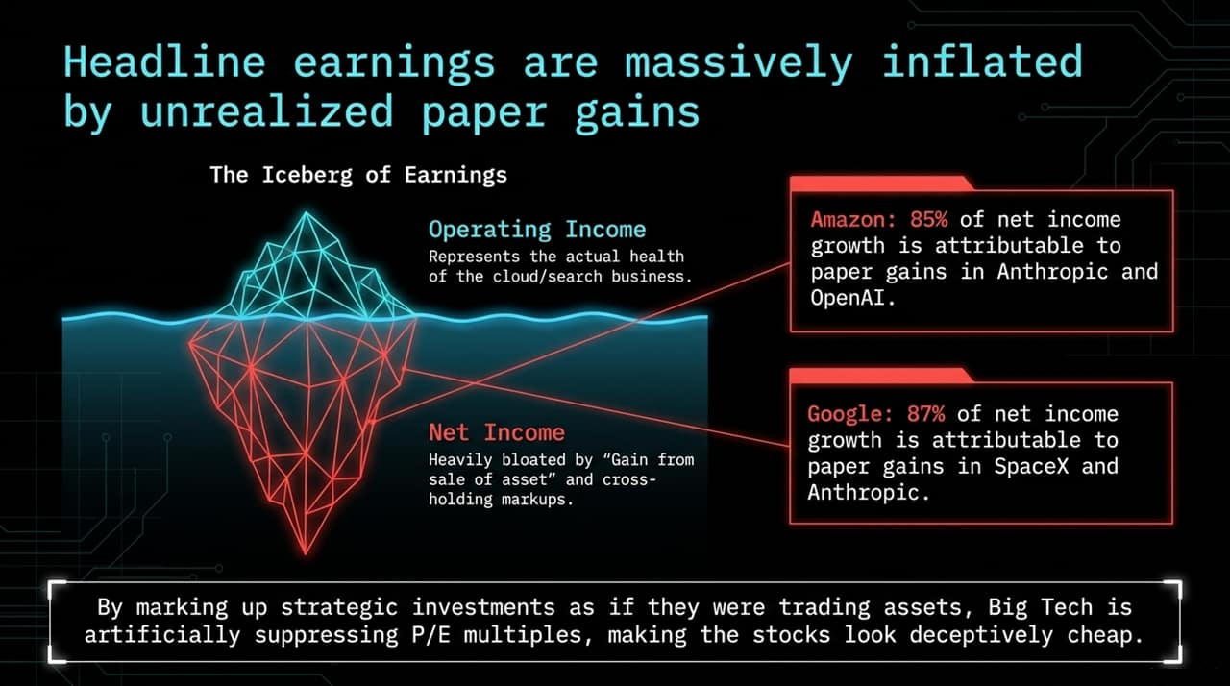
Notes:
Accounting Noise Behind Net Income: Headline net income figures for hyperscalers have looked exceptionally strong, leading to artificially low trailing P/E multiples. However, a closer look at the income statements reveals significant non-operating inflation:
Amazon: 85% of recent net income growth is driven by unrealized, non-operating paper gains from marking up its stakes in Anthropic/OpenAI.
Google: 87% of net income growth stems from non-operating markups on investments like SpaceX and Anthropic.
The P/E Distortion: Marking up strategic investments under accounting line items like "Gain from sale/holding of asset" suppresses P/E ratios, making these equities look deceptively cheap. Operating income—the core cloud and search engines—tells a much more modest, realistic growth story.

Slide 8
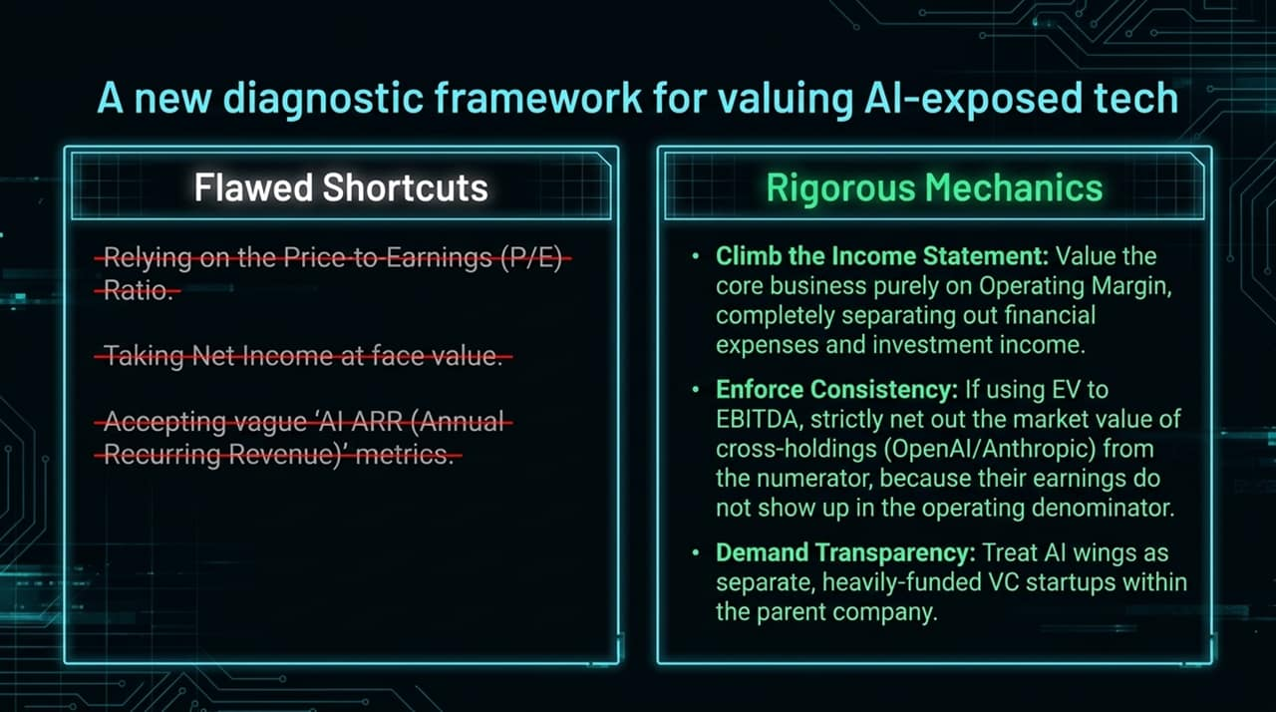
Notes:
Flawed Shortcuts to Avoid:
Do not rely on standard trailing P/E ratios.
Do not take Net Income at face value.
Reject vague corporate metrics like "AI Annual Recurring Revenue (ARR)" which aggregate internal compute circularity.
Rigorous Valuation Mechanics:
Climb the Income Statement: Evaluate core businesses purely on Operating Income / EBIT, isolating financial income, markups, and one-off investment gains.
Enforce Multiples Consistency: If utilizing EV/EBITDA, strictly net out the market value of minority cross-holdings (OpenAI, Anthropic, SpaceX) from the numerator, because their operating earnings do not flow into the denominator.
Demand Segment Transparency: Analysts should treat internal AI buildouts as separate, heavily funded venture capital bets operating within the parent company, evaluating their standalone cash burns.

Slide 9
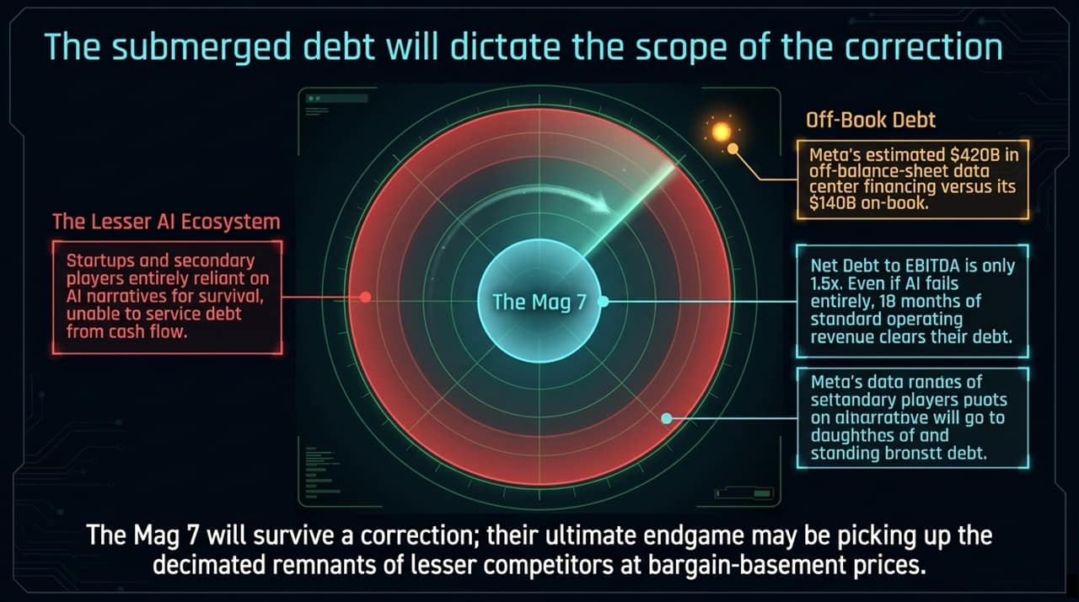
Notes:
Balance Sheet Resilience vs. Hidden Debt:
The Mag 7 Safety Net: The Mag 7 carry strong balance sheets with Net Debt to EBITDA ratios averaging ~1.5x. Even if AI investments yield zero return, 18 months of core operating cash flow clears their on-book debt.
Off-Balance Sheet Data Center Debt: However, off-book financing is growing rapidly. Meta, for instance, holds an estimated $420B in off-balance-sheet data center leases and financing partnerships compared to $140B on-book.
The Secondary Ecosystem Hazard: While the Mag 7 will survive an AI market correction, the "Lesser AI Ecosystem"—over-leveraged startups, non-cash-flow-positive vendors, and secondary tier players—will face severe distress.
The Endgame: Big Tech may ultimately benefit from an AI market shakeout, acquiring distressed assets and infrastructure from bankrupt competitors at deep discounts.

Slide 10
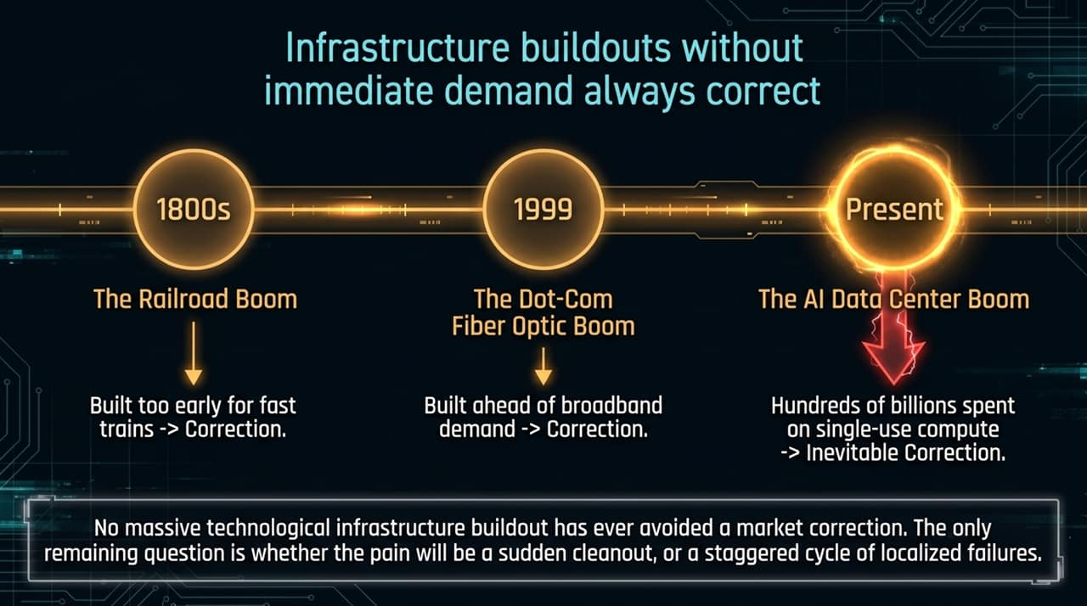
Notes:
Historical Perspective: No major technological infrastructure buildout in modern economic history has ever avoided a market correction:
1800s Railroad Boom: Built thousands of miles of track decades ahead of high-speed train technology, resulting in massive rail bankruptcies before achieving long-term utility.
1999 Dot-Com Telecom Boom: Laid millions of miles of dark fiber optic cables ahead of actual consumer broadband demand, leading to a severe market crash.
Present AI Data Center Boom: Hundreds of billions invested in single-use compute clusters ahead of proven end-user monetization.
The Core Conclusion: The question is not if an adjustment occurs, but how—whether through a sudden, sharp cleanout or a prolonged, staggered cycle of localized failures.

Slide 11
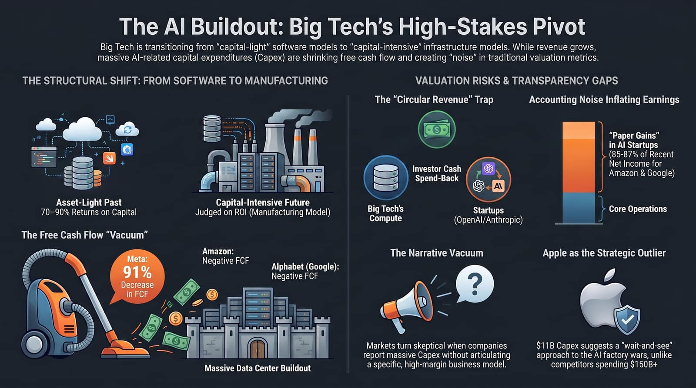
Notes:
Comprehensive Summary: To wrap up our diagnostic, Slide 11 synthesizes the overarching structural shift and valuation dynamics across four dimensions:
Structural Shift: Transitioning from asset-light, 70–90% ROIC software models to capital-intensive, manufacturing-style infrastructure buildouts.
Free Cash Flow Vacuum: Unprecedented CapEx spend has driven free cash flow into negative territory for Amazon and Google, while Meta saw a 91% drop in FCF.
Accounting & Circularity Risks: Round-tripping vendor flows (73–74% of AI revenues coming from strategic partners) paired with paper investment markups (85–87% of net income growth) hide true operating realities.
Strategic Takeaway: The market is increasingly demanding transparency. Companies that articulate clear, sustainable business models and enforce capital discipline will navigate the upcoming cycle successfully, while those relying on narrative-driven spend risk significant market repricing.

